Slide 1
COMP 520 - Compilers
Lecture 08 – Shift/Reduce and Identification/Type Checking

Slide 2
WA1 Clarification on Choice / Choice Points
a|b|c has choice points for one decision (which is frustratingly also called “one choice”)
I don’t like this notation, so I removed the “how many choices” question.
Word “choice” feels overloaded.
COMP 520: Compilers – S. Ali

Slide 3
WA2 Released Today
Due in 10 days on the 19th (Monday)
Note: An arbitrary sequence can be any sequence!
Reminder: Midterm on the 22nd (Thursday)
COMP 520: Compilers – S. Ali

Slide 4
Monday, Tuesday (2/12-2/13) Wellness Day
No office hours, we will be busy working on wellness
COMP 520: Compilers – S. Ali

Slide 5
Stratified Grammars and left-to-right Order
Question: Are same-precedence operations in a stratified grammar processed in left-to-right order?
By processed, I mean when emulated like in the Lec 06, Slide 41.
You can practice this in WA2!
COMP 520: Compilers – S. Ali

Slide 6
Short Recap on Left-Factorization
Recall the fearsome four in PA1:
Type id = Expression ;
Reference = Expression ;
Reference [ Expression ] = Expression ;
Reference ( ArgumentList? ) ;
COMP 520: Compilers – S. Ali

Slide 7
Break up each rule using literals
Type id = Expression ;
Reference = Expression ;
Reference [ Expression ] = Expression ;
Reference ( ArgumentList? ) ;
(boolean|(int|id)([])?) id = …
(id|this)(.id)* = …
(id|this)(.id)* [ Expression ] = …
(id|this)(.id)* ( ArgumentList? ) ;
COMP 520: Compilers – S. Ali

Slide 8
Left Factorization
Can be viewed as a deterministic state machine
Each edge is an “if” statement
Each node is an accept/parse
Rules of the form A ::= $αβ_{1} | αβ_{2}$
Rewritten as:
A ::= $α$A’
A’ ::= $β_{1} | β_{2}$ (and vice versa)
COMP 520: Compilers – S. Ali

Slide 9
Create a State Machine
boolean|int
S
parseVarDeclStmt();
Note: I am using a short-hand notation for “parse the rest”
COMP 520: Compilers – S. Ali

Slide 10
Create a State Machine (2)
parseVarDeclStmt();
boolean|int
Note: I am using a short-hand notation for “parse the rest”
parseReference();
S
this
“(”
“=”
“[”
COMP 520: Compilers – S. Ali

Slide 11
Create a State Machine (3)
parseVarDeclStmt();
boolean|int
parseReference();
S
parseCallStmt(refAST);
this
“(”
“=”
“[”
*Note, you do not have to make these parse methods, this is just an example
parseIxAssignStmt(refAST);
parseAssignStmt(refAST);
COMP 520: Compilers – S. Ali

Slide 12
Create a State Machine (4)
…
parseVarDeclStmt(typeDenoter);
boolean |int
Note: I am using a short-hand notation for “parse the rest” given a typeDenoter
id
S
id
…
this
“.”
“[”
“]”
Expr
parseVarDecl(refAST);
parseIxAssignStmt(refAST);
COMP 520: Compilers – S. Ali

Slide 13
Create a State Machine (5)
…
parseVarDeclStmt(typeDenoter);
boolean |int
Note: I am using a short-hand notation for “parse the rest” given a typeDenoter
id
(.id)*
S
id
…
“=”
parseAssignStmt(refAST);
this
neither
“[”
“[”
“(”
“]”
parseCallStmt(refAST);
Expr
parseIxAssignStmt(refAST);
parseVarDecl(refAST);
parseIxAssignStmt(refAST);
COMP 520: Compilers – S. Ali

Slide 14
parseVarDeclStmt();
parseCallStmt(refAST);
parseVarDeclStmt(typeDenoter);
boolean|int
“(”
id
(.id)*
parseAssignStmt(refAST);
“[”
“this”
S
“=”
parseReference();
id
not id or [
parseIxAssignStmt(refAST);
“[”
“=”
“[”
“(”
“]”
parseCallStmt(refAST);
parseAssignStmt(refAST);
Expr
parseVarDeclStmt(refAST);
Expr
parseIxAssignStmt(refAST);
parseIxAssignStmt(refAST);
COMP 520: Compilers – S. Ali

Slide 15
parseVarDeclStmt();
parseCallStmt(refAST);
parseVarDeclStmt(typeDenoter);
boolean|int
“(”
id
(.id)*
parseAssignStmt(refAST);
“[”
“this”
S
“=”
parseReference();
id
not id or [
parseIxAssignStmt(refAST);
“[”
“=”
“[”
“(”
“]”
parseCallStmt(refAST);
parseAssignStmt(refAST);
Expr
parseVarDeclStmt(type);
Expr
parseIxAssignStmt(refAST);
parseIxAssignStmt(refAST);
COMP 520: Compilers – S. Ali

Slide 16
Original Fearsome Four
F ::= Type id = Expression ;
| Reference = Expression ;
| Reference [ Expression ] = Expression ;
| Reference ( ArgumentList? ) ;
Ignore the other types of Statements and only look at these four (assume no other rule for F exists).
COMP 520: Compilers – S. Ali

Slide 17
New Grammar
this(.id)*(= Expr ;| [Expr] = Expr ; | ( ArgList? ) ; )
| boolean id = Expr ;
| id (
( (.id)*( = Expr ; | [ Expr ] = Expr ; | ( ArgList? ) ; ) )
| [] id = Expr ;
)
Is it LL(1)?
COMP 520: Compilers – S. Ali

Slide 18
Let’s informally investigate
COMP 520: Compilers – S. Ali

Slide 19
Eyeball Starters
this(.id)*(= Expr ;| [Expr] = Expr ; | ( ArgList? ) ; )
| boolean id = Expr ;
| id (
( (.id)*( = Expr ; | [ Expr ] = Expr ; | ( ArgList? ) ; ) )
| [] id = Expr ;
)
So far so good
COMP 520: Compilers – S. Ali

Slide 20
Eyeball Starters (2)
this(.id)*(= Expr ;| [Expr] = Expr ; | ( ArgList? ) ; )
Question: are the predict sets in this disjoint?
COMP 520: Compilers – S. Ali

Slide 21
Eyeball Starters (3)
this(.id)*(= Expr ;| [Expr] = Expr ; | ( ArgList? ) ; )
Question: are the predict sets in this disjoint?
(Note: Nullable( (.id)* ) = $true$)
Eyeball it, looks like we have: . = [ (
COMP 520: Compilers – S. Ali

Slide 22
Eyeball Starters (4)
Eyeball it again with starters: what are the starters?
| id (
( (.id)*( = Expr ; | [ Expr ] = Expr ; | ( ArgList? ) ; ) )
| [] id = Expr ;
)
COMP 520: Compilers – S. Ali

Slide 23
Eyeball Starters (5)
Eyeball it again with starters: . = [ (
| id (
( (.id)*( = Expr ; | [ Expr ] = Expr ; | ( ArgList? ) ; ) )
| [] id = Expr ;
)
Any problems here?
COMP 520: Compilers – S. Ali

Slide 24
Fix the problem in the Scanner
Eyeball it again with starters: . = [ ( []
| id (
( (.id)*( = Expr ; | [ Expr ] = Expr ; | ( ArgList? ) ; ))
| [] id = Expr ;
)
Make this a token by itself. Will not affect the scanning of other tokens.
COMP 520: Compilers – S. Ali

Slide 25
Final Grammar (again)
this(.id)*(= Expr ;| [Expr] = Expr ; | ( ArgList? ) ; )
| boolean id = Expr ;
| id ( ( (.id)*( = Expr ; | [ Expr ] = Expr ; | ( ArgList? ) ; ) )
| [] id = Expr ; )
Is it LL(1) now?
In other words, by only looking at the next token, can I deterministically make decisions?
COMP 520: Compilers – S. Ali

Slide 26
Usefulness of Grammar Transformations
Fearsome four made a lot easier through our Compiler CFG theory lectures! But automatically generating a Parser still has areas for optimization. Note the heavily reused sequences:
this(.id)*(= Expr ;| [Expr] = Expr ; | ( ArgList? ) ; )
| boolean id = Expr ;
| id (( (.id)*( = Expr ; | [ Expr ] = Expr ; | ( ArgList? ) ; ) )
| [] id = Expr ; )
COMP 520: Compilers – S. Ali

Slide 27
Bottom-Up Parsing
Shift-Reduce parsing
COMP 520: Compilers – S. Ali

Slide 28
Bottom-Up Parsing
Also known as a shift-reduce parser
Mechanism is:
Stack for your state
Production Rules (your CFG)
State Table (State x Token) $→$ ( Action, NextState/ProdRule )
Non-Terminal Table (State x Non-Terminal) $→$ State
Once your data structures are correctly set up, it works pretty much by itself.
COMP 520: Compilers – S. Ali

Slide 29
Current State = Top of Stack, then either…
Shift(nextState,Token)
Reduce(prodNum)
Push state onto stack
Push token onto stack
Get next input
Note, state and token may be implemented with separate stacks in some implementations of shift-reduce
For the length of the production, pop state and tokens
Push that production rule’s non-terminal to the stack
Push the next state depending on the Non-terminal x state table
COMP 520: Compilers – S. Ali

Slide 30
Bottom-Up (Shift-Reduce) Example
COMP 520: Compilers – S. Ali

Slide 31
Production Rules (CFG)
E ::= E + T
E ::= T
T ::= T * F
T ::= F
F ::= ( E )
F ::= id
COMP 520: Compilers – S. Ali

Slide 32
State, Non-terminal, and Prod Table
State x Token -> ( Shift/Reduce, State/ProdNum )
State | id | + | * | ( | ) | $
0 | s5 |  |  | s4
1 |  | s6 |  |  |  | stop
2 |  | r2 | s7 |  | r2 | r2
3 |  | r4 | r4 |  | r4 | r4
4 | s5 |  |  | s4
5 |  | r6 | r6 |  | r6 | r6
6 | s5 |  |  | s4
7 | s5 |  |  | s4
8 |  | s6 |  |  | s11
9 |  | r1 | s7 |  | r1 | r1
10 |  | r3 | r3 |  | r3 | r3
11 |  | r5 | r5 |  | r5 | r5
State x NT -> Next State
State | E | T | F
0 | 1 | 2 | 3
1
2
3
4 | 8 | 2 | 3
5
6 |  | 9 | 3
7 |  |  | 10
8
9
10
11
Production Rules
R# | Rule
1 | E ::= E + T
2 | E ::= T
3 | T ::= T * F
4 | T ::= F
5 | F ::= ( E )
6 | F ::= id
COMP 520: Compilers – S. Ali

Slide 33
Consider the input w:
E ::= E + T
E ::= T
T ::= T * F
T ::= F
F ::= ( E )
F ::= id
w= a + b * c $
Initialize state stack: { 0 }
Initialize symbol stack: { }
COMP 520: Compilers – S. Ali

Slide 34
Consider the input w:
E ::= E + T
E ::= T
T ::= T * F
T ::= F
F ::= ( E )
F ::= id
w= a + b * c $
Current State = top(StateStack) = 0
Current Input = id
Symbol Stack = {}
State0 x id = s5 (Shift)
Thus, push “id” on symbol stack
push state 5 on state stack, get next input
State | id | + | * | ( | ) | $
0 | s5 |  |  | s4
COMP 520: Compilers – S. Ali

Slide 35
Consider the input w:
E ::= E + T
E ::= T
T ::= T * F
T ::= F
F ::= ( E )
F ::= id
w= a + b * c $
StateStack= { 5, 0 }
SymbolStack= { a }
r6 -> Reduce on prod # 6
State | id | + | * | ( | ) | $
5 |  | r6 | r6 |  | r6 | r6
Prod | Rule
6 | F ::= id
State | E | T | F
0 | 1 | 2 | 3
COMP 520: Compilers – S. Ali

Slide 36
Consider the input w:
E ::= E + T
E ::= T
T ::= T * F
T ::= F
F ::= ( E )
F ::= id
w= a + b * c $
StateStack= { 5, 0 }
SymbolStack= { a }
r6 -> Reduce on prod # 6
- Prod length is 1, so pop both stacks once
- In [new] state 0, prod rule was “F”, so push “F” and next state of 3
State | id | + | * | ( | ) | $
5 |  | r6 | r6 |  | r6 | r6
Prod | Rule
6 | F ::= id
State | E | T | F
0 | 1 | 2 | 3
COMP 520: Compilers – S. Ali

Slide 37
Consider the input w:
E ::= E + T
E ::= T
T ::= T * F
T ::= F
F ::= ( E )
F ::= id
w= a + b * c $
StateStack= { 3, 0 }
SymbolStack= { F }
-> r4 (Reduction on Prod 4)
( pop once on both, push T, push new state 2 )
State | id | + | * | ( | ) | $
3 |  | r4 | r4 |  | r4 | r4
Prod | Rule
4 | T ::= F
State | E | T | F
0 | 1 | 2 | 3
COMP 520: Compilers – S. Ali

Slide 38
Consider the input w:
E ::= E + T
E ::= T
T ::= T * F
T ::= F
F ::= ( E )
F ::= id
w= a + b * c $
StateStack= { 2, 0 }
SymbolStack= { T }
-> r2 (Reduction on Prod 2)
( pop once on both, push E, push new state 1 )
State | id | + | * | ( | ) | $
2 |  | r2 | s7 |  | r2 | r2
Prod | Rule
2 | E ::= T
State | E | T | F
0 | 1 | 2 | 3
COMP 520: Compilers – S. Ali

Slide 39
Consider the input w:
E ::= E + T
E ::= T
T ::= T * F
T ::= F
F ::= ( E )
F ::= id
w= a + b * c $
StateStack= { 1, 0 }
SymbolStack= { E }
-> s6 (Shift, next state 6)
( push ‘+’, read next input, push state 6)
State | id | + | * | ( | ) | $
1 |  | s6 |  |  |  | stop
COMP 520: Compilers – S. Ali

Slide 40
Consider the input w:
E ::= E + T
E ::= T
T ::= T * F
T ::= F
F ::= ( E )
F ::= id
w= a + b * c $
StateStack= { 6, 1, 0 }
SymbolStack= { +, E }
-> s5 (Shift, next state 5)
( push ‘id’, read next input, push state 5)
State | id | + | * | ( | ) | $
6 | s5 |  |  | s4
COMP 520: Compilers – S. Ali

Slide 41
Consider the input w:
E ::= E + T
E ::= T
T ::= T * F
T ::= F
F ::= ( E )
F ::= id
w= a + b * c $
StateStack= { 5, 6, 1, 0 }
SymbolStack= { id, +, E }
-> r6 (Reduction on Prod 6)
( pop one from both stacks, push F, push 3 )
State | id | + | * | ( | ) | $
5 |  | r6 | r6 |  | r6 | r6
Prod | Rule
6 | F ::= id
State | E | T | F
6 |  | 9 | 3
COMP 520: Compilers – S. Ali

Slide 42
Skip ahead a bit
(Change the id on the stack to T)
COMP 520: Compilers – S. Ali

Slide 43
Consider the input w:
E ::= E + T
E ::= T
T ::= T * F
T ::= F
F ::= ( E )
F ::= id
w= a + b * c $
StateStack= { 9, 6, 1, 0 }
SymbolStack= { T, +, E }
-> s7 (Shift, push next state 7)
State | id | + | * | ( | ) | $
9 |  | r1 | s7 |  | r1 | r1
COMP 520: Compilers – S. Ali

Slide 44
Consider the input w:
E ::= E + T
E ::= T
T ::= T * F
T ::= F
F ::= ( E )
F ::= id
w= a + b * c $
StateStack= { 7, 9, 6, 1, 0 }
SymbolStack= { *, T, +, E }
-> s5 (Shift, push next state 5)
State | id | + | * | ( | ) | $
7 | s5 |  |  | s4
COMP 520: Compilers – S. Ali

Slide 45
Consider the input w:
E ::= E + T
E ::= T
T ::= T * F
T ::= F
F ::= ( E )
F ::= id
w= a + b * c $
StateStack= { 5, 7, 9, 6, 1, 0 }
SymbolStack= { id, *, T, +, E }
-> r6
State | id | + | * | ( | ) | $
5 |  | r6 | r6 |  | r6 | r6
Prod | Rule
6 | F ::= id
State | E | T | F
6 |  | 9 | 3
COMP 520: Compilers – S. Ali

Slide 46
Remainder
E ::= E + T
E ::= T
T ::= T * F
T ::= F
F ::= ( E )
F ::= id
w= a + b * c $
SymbolStack= { id, *, T, +, E }
What happens next:
F * T + E
T + E
E
Skip more of “change id to NT”
COMP 520: Compilers – S. Ali

Slide 47
Out-of-precedence-order?
Step | Symbol Stack
0 | id
1 | F
2 | T
3 | * T
4 | id * T
5 | F * T
6 | T
7 | E
8 | + E
9 | id + E
 | …
11 | T + E
12 | E
Consider: w = a * b + c $
Note how the multiply (higher precedence) will combine into T before the lower precedence addition.
COMP 520: Compilers – S. Ali

Slide 48
Example of Shift-Reduce Parser on Website
Example is in C++
Once the table is built for the grammar, the parsing code remains the same.
Note: the switch statement for REDUCE can be changed to a table as well (with prod lengths and what NT is pushed)
COMP 520: Compilers – S. Ali

Slide 49
Reduce-Reduce conflicts
General idea:
A ::= $α$
B ::= $α$
And top of the stack contains $α$
Do we reduce with prod A or prod B?
COMP 520: Compilers – S. Ali

Slide 50
Reduce-Reduce Conflicts (From gnu.org)
sequence:
%empty { printf(“empty seq”); }
| maybeword
| sequence word { printf(“added word %s”, $2); }
maybeword:
%empty { printf(“empty maybeword”); }
| word { printf(“single word %s”); }
COMP 520: Compilers – S. Ali

Slide 51
Another common conflict
Stmt ::= if (Expr) Stmt
| if (Expr) Stmt else Stmt
If we see the input “if (Expr) Stmt” on the stack, and the next symbol is “else”, do we reduce or shift?
Consider: if( true ) if( true ) else a = b;
COMP 520: Compilers – S. Ali

Slide 52
Identification
COMP 520: Compilers – S. Ali

Slide 53
Three scopes in miniJava
Class Names
Member Names (fields and methods)
Parameters / Local variables
COMP 520: Compilers – S. Ali

Slide 54
miniJava Context
Give each a “level” and create some rules
Level 0: Class Names
Level 1: Member Names
Level 2+: Method Parameters & Local Variables
COMP 520: Compilers – S. Ali

Slide 55
miniJava Context
Give each a “level” and create some rules
Level 0: Class Names
Level 1: Member Names
Level 2+: Method Parameters & Local Variables
How does this work in Java?
COMP 520: Compilers – S. Ali

Slide 56
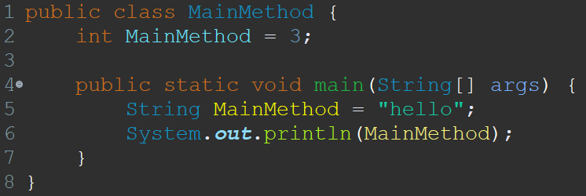
A perfectly sane Java program
COMP 520: Compilers – S. Ali

Slide 57
miniJava Context
Give each scope a “level” and create some rules
Level 0: Class Names
Level 1: Member Names
Level 2+: Method Parameters & Local Variables
Anything in the 2+ category cannot override anything else in 2+. Other than that, higher scope levels can override lower scope levels.
COMP 520: Compilers – S. Ali

Slide 58
Revisit Identifier
An identifier has a name and a context
An identifier can be…
COMP 520: Compilers – S. Ali

Slide 59
Identifiers
Category | Definition
Local Variable (or Parameter) | Defined locally for that method
Method | Identifier is for a method
Type | Identifier is for a class type
Class Name | Identifier used for statics or new expressions. e.g. CLASSNAME.x or new CLASSNAME()
Field Variable | Identifier is specific to a dynamic object (a.b)
Namespace | C++, useful for resolving conflicts, packages everything inside the namespace and can be renamed.
Pre-defined | E.g. System.out.println
COMP 520: Compilers – S. Ali

Slide 60
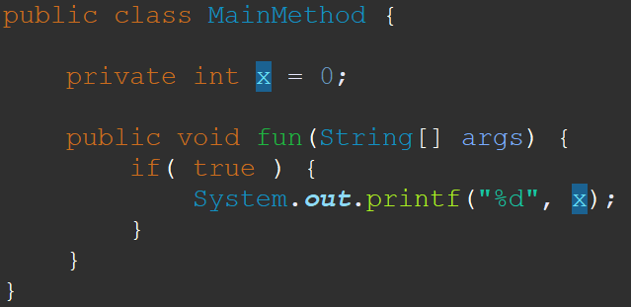
Identifiers make sense in context
Identifier x Context $→$ Declaration
When no given context, context is the current class
COMP 520: Compilers – S. Ali

Slide 61
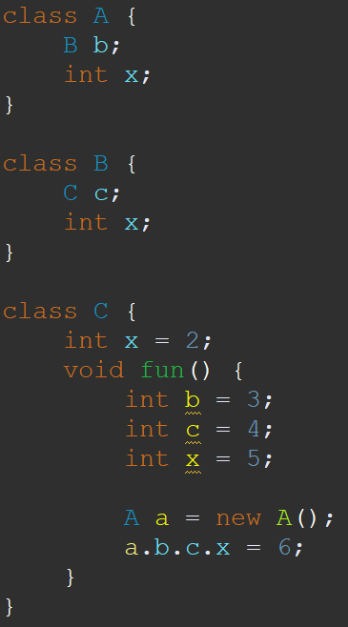
Not yet declared??
Note: B is defined after A
Java is doing something special that is not “in-order.”
You will have to tackle this problem too!
COMP 520: Compilers – S. Ali

Slide 62
Where is a.b.c.x’s declaration?
x is in the context of c,
c is in the context of b
b is in the context of a
a was declared as an “A” object
COMP 520: Compilers – S. Ali

Slide 63
Where is a.b.c.x’s declaration?
x is in the context of c,
c is in the context of b
b is in the context of a
a was declared as an “A” object
a: a is of type “A”
a.b: b in context of “A”, type is “B”
a.b.c: c in context of “B”, type is “C”
a.b.c.x: x in context of “C”
COMP 520: Compilers – S. Ali

Slide 64
Where is x’s declaration?
a: a is of type “A”
a.b: b in context of “A”, type is “B”
a.b.c: c in context of “B”, type is “C”
a.b.c.x: x in context of “C”
$∴$ QualRef “a.b.c.x” is defined here
{“ID x”} x {“ctx C”} $→$ FieldDecl
COMP 520: Compilers – S. Ali

Slide 65
Identification Theory
As identifiers are declared (ClassDecl, VarDecl, etc.)… keep a table of their context.
IDTable: (id $×$ ctx) $→$ Declaration
Input is (id,ctx), output is Declaration
(Note: if (a,b) $∉$ IDTableInputs, then id error)
But what exactly is a context?
COMP 520: Compilers – S. Ali

Slide 66
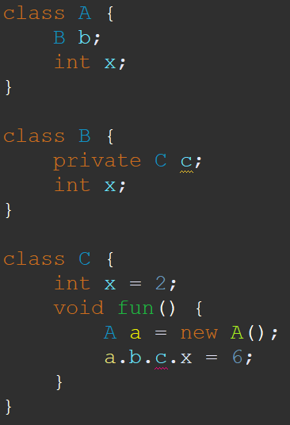
Context Visibility
The context of an identifier is the class it is defined in.
Not all entries are available at all times.
COMP 520: Compilers – S. Ali

Slide 67
Context Visibility
The context of an identifier is the class it is defined in.
Not all entries are available at all times.
When resolving a.b.c, the entry: {“ID c”} x {“CTX B”} $→$ FieldDecl is unavailable when inside C.fun
COMP 520: Compilers – S. Ali

Slide 68
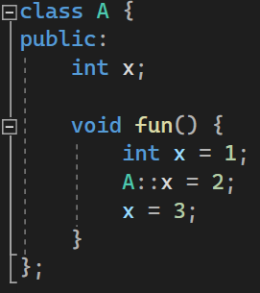
Context Invisibility
Some languages let you manually specify context.
Shown on the right is C++.
Can use language’s syntax to bypass hidden contexts (in this case, local variable hides field variable)
COMP 520: Compilers – S. Ali

Slide 69
Scoped Identification
Your ID Table can be seen as a stack.
When a new scope occurs (with a block statement{…}) then you get a new ID table pushed on the stack.
Other than for QualRef, check the top-most ID table, and work your way down to find the Declaration
COMP 520: Compilers – S. Ali

Slide 70
Example (1) – Jan Prins
Current Context:
“Foo.x”, “Foo.p”
“local.y”
“local.x”
COMP 520: Compilers – J. Prins

Slide 71
Example (2) – Jan Prins
Current Context:
“Foo.x”, “Foo.p”
“local.y”
No more “local.x”
COMP 520: Compilers – J. Prins

Slide 72
Identification Traversal
At each node, we can update the ID table.
Updates can be to a global ID table, or you can return an updated table while traversing.
Update may be to hide identifiers that should now be invisible (private variables, or hiding level 0 and 1 with a new 2+ variable).
COMP 520: Compilers – S. Ali

Slide 73
Identification Traversal
At each node, we can update the ID table.
Updates can be to a global ID table, or you can return an updated table while traversing.
Update may be to hide identifiers.
Question: Why is a global table not desirable? (Think about –j flag on gcc)
COMP 520: Compilers – S. Ali

Slide 74
Type Checking
COMP 520: Compilers – S. Ali

Slide 75
Type-Checking Table
For every type, should there be an entry where…
$$α×β→γ$$
E.g., int $×$ int $→$ int
Is this enough?
Will every int op int yield an int?
COMP 520: Compilers – S. Ali

Slide 76
Type-Checking Table (2)
For every type, should there be an entry where…
$$α×β→γ$$
E.g., int $×$ int $→$ int
What about 3 == 2? In that case, int $×$ int $→$ boolean
COMP 520: Compilers – S. Ali

Slide 77
Type-Checking Table (3)
Therefore, Type-Checking is a 3 input, 1 output table:
( $β$ $×$ $α$ $×$ op ) $→$ $γ$
E.g., int $×$ int $×$ {+,-,*,/} $→$ int
int $×$ int $×$ {==,!=,>,>=,<,<=} $→$ boolean
COMP 520: Compilers – S. Ali

Slide 78
Operator Overloading
Operator Overloading: give custom definitions to ops
Example, consider a “MyData” object that can accumulate integers and sorts them.
In C++, can create a method that defines:
MyData $×$ int $×$ {+} $→$ MyData
Where adding integers to MyData types will call that method.
COMP 520: Compilers – S. Ali

Slide 79
Bad Types
When an entry is missing, then the resultant type should be a specially designated type that is compatible with EVERY type.
This type, “ErrorType”, prevents type-checking errors from filling up your compiler’s error log.
COMP 520: Compilers – S. Ali

Slide 80
Bad Types (2)
This type, “ErrorType”, prevents type-checking errors from filling up your compiler’s error log.
Consider miniJava: (myObj + 3) + 5;
ClassType $×$ int $×$ {+} $→$ ErrorType (report error here)
ErrorType $×$ int $×$ {+} $→$ ErrorType (no need to report)
Second type check was valid.
COMP 520: Compilers – S. Ali

Slide 81
Bad Types (3)
Generalization:
( {ErrorType} $×$ AnyType $×$ AnyOp ) $→$ ErrorType
( AnyType $×$ {ErrorType} $×$ AnyOp ) $→$ ErrorType
( (TypeA,TypeB,Op) $∉$ TypeTable ) $→$ (Result=ErrorType)
( (TypeA,TypeB,Op) $∈$ TypeTable ) $→$ ( Result = GetEntry(TypeA,TypeB,Op) )
COMP 520: Compilers – S. Ali

Slide 82
Does Order Matter?
Is A $×$ B the same as B $×$ A?
COMP 520: Compilers – S. Ali

Slide 83
Does Order Matter?
Is A $×$ B the same as B $×$ A?
Previous definitions state yes.
Your thoughts?
COMP 520: Compilers – S. Ali

Slide 84
Does Order Matter?
Is A $×$ B the same as B $×$ A?
Previous definitions state yes.
Not for miniJava, but yes for some languages.
Why?
COMP 520: Compilers – S. Ali

Slide 85
Order – Language Specifications
Language may specify that order can matter
C++ can specify order in the program itself:
COMP 520: Compilers – S. Ali

Slide 86
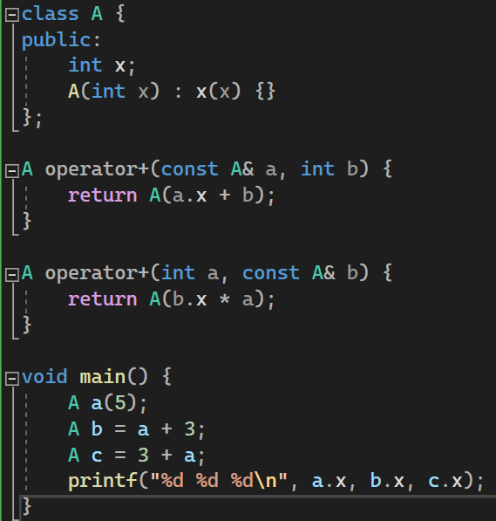
More Totally Sane Code
Why?
COMP 520: Compilers – S. Ali

Slide 87
More Totally Sane Code
Why?
You could make your compiler “keep” the first type if you wanted.
For example: 3 + 3.2 * 4.4;
Specify: int $×$ float … $→$ int
Specify: float $×$ int … $→$ float
COMP 520: Compilers – S. Ali

Slide 88
Type-Checking Table
Thus, how you construct your type checking table depends on the language.
COMP 520: Compilers – S. Ali

Slide 89
TypeCasting Tables
COMP 520: Compilers – S. Ali

Slide 90
TypeCasting / Type Conversions
Typecasting (or the conversion of a type) does not have an operator.
Formally:
$$α×β→α$$
Thus, the table for typecasting is: (TypeA,TypeB) $→$ TypeA, and some skip the $→$ entirely
E.g. ( (int)3.4f ) $→$ 3 (an int), which is (int,float)$→$int
COMP 520: Compilers – S. Ali

Slide 91
TypeCasting / Type Conversions (2)
$$α×β→α$$
The table for typecasting takes an input of (TypeA,TypeB), result is just TypeA.
If (x,y) $∉$ Table, then this is a type checking error.
The table usually has a result just to make the code easier to write up.
What is the exception?
COMP 520: Compilers – S. Ali

Slide 92
Automatic Conversions
boolean is just a 0 or 1, so we could:
int $×$ boolean $→$ int
boolean $×$ int $→$ boolean
This is also described as:
int $→$ {int, boolean}
(depends on how you construct the table)
COMP 520: Compilers – S. Ali

Slide 93
Automatic Conversions (2)
Java has more automatic conversions:
String $×$ Enum $→$ String
The Enum will automatically become a string that represents the text of that enum entry.
COMP 520: Compilers – S. Ali

Slide 94
Automatic Conversions (3)
Automatic conversions are AUTOMATIC
Note:
private int somefun( int a ) { … }
…
somefun( true );
… does not require explicitly typecasting (int)true
COMP 520: Compilers – S. Ali

Slide 95
Automatic Conversions (4)
Java has more automatic conversions:
String $×$ Enum $→$ String
Combine this with: String $×$ String $×$ {+} $→$ String (concatenation operation) and we can add enum to strings!
E.g.: myStr = myStr + someEnumVar;
COMP 520: Compilers – S. Ali

Slide 96
Automatic Type Casting Note
From the previous example, we can see that if there does not exist a type-check entry for:
$α×β×$ Op
… then we have to check all possible automatic typecasting for both $α$ and $β$.
If there exists conflicts, manual typecasting is enforced.
COMP 520: Compilers – S. Ali

Slide 97
Manual Typecasting
Consider the following:
(String,String,+)$→$String
(Integer,Integer,+)$→$Integer
TypeA a; TypeB b;
And both TypeA and TypeB can be typecasted with:
(String,TypeA), (String,TypeB), (Integer,TypeA), (Integer,TypeB)
What is the result type of a + b?
COMP 520: Compilers – S. Ali

Slide 98
Manual Typecasting
Consider the following:
(String,String,+)$→$String
(Integer,Integer,+)$→$Integer
TypeA a; TypeB b; both TypeA, TypeB $→$ {String,Integer}
What is the result type of a + b?
Answer: Your compiler must require a or b to be manually typecasted to either String or Integer. (String)a + b;
COMP 520: Compilers – S. Ali

Slide 99
Please note: miniJava
miniJava does not have typecasting nor automatic conversions.
miniJava does not allow boolean $×$ int $×$ Op
This lecture is meant to strengthen your compiler theory, please see next lecture for PA3 specifics.
COMP 520: Compilers – S. Ali

Slide 100
Enjoy your weekend!
Make sure to wrap up WA1
Make sure to start on WA2
Start early on PA2!
There will be questions on the midterm on how you solved problems in PA1+PA2!!
COMP 520: Compilers – S. Ali

Slide 101
End

Slide 102
COMP 520: Compilers – S. Ali

Slide 103
COMP 520: Compilers – S. Ali

Slide 104
COMP 520: Compilers – S. Ali

Slide 105
COMP 520: Compilers – S. Ali

